Slide 1


FYP
Proposal
Society Management System
Hamdard University

Slide 2
Group Introduction
Members:
M. Areeb Vohra [BSCS/F14/0112]
M. Taha Amin [BSCS/F14/0117]
Abdul Moiz Hussain [BSCS/F14/0128]
Supervisor:
Sir Adnan Ahmed Siddiqui (Assist. Professor)
Co-supervisor:
Sir M. Fahad

Slide 3
Summary
Problem Statement
Motivation
Aims & Objectives
Project Scope (Big Picture & Cycle Diagram)
Literature Reviews
Methodology
Project Plan (Gantt Chart)
RACI Chart
Project Tools
Budgeting
Project Deliverables
References

Slide 4
Problem Statement
In housing societies, problems regarding any household issues like electricity, plumbing, gas leakage, carpentry, fumigation, etc. the person himself has to go and bring the repair man, which takes a lot of time and effort.

Slide 5
Motivation
The proposed project introduces the application which will integrate society’s every problem on a platform, and the problem will be few clicks away to be solved.

Slide 6
Aims & Objectives
The main objective of this project is to develop a web & smart-phone based application that can be used to inform about any of the household problem in an easier way.
Due to the common use and access of androids and web pages, these platforms are targeted for this project’s UI.
And definitely a web based Service Control Manager, where all the required services of the citizens will be submitted & processed.

Slide 7
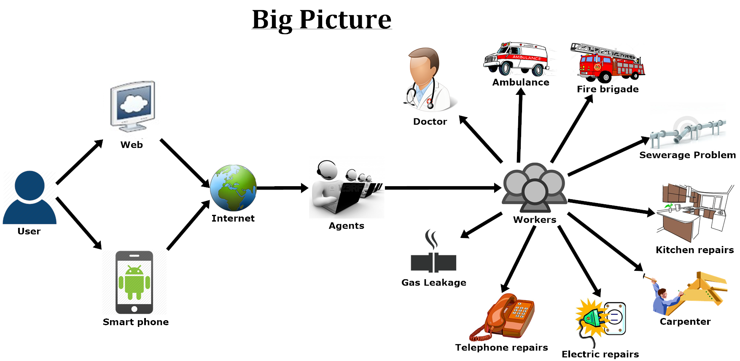
Project Scope

Slide 8
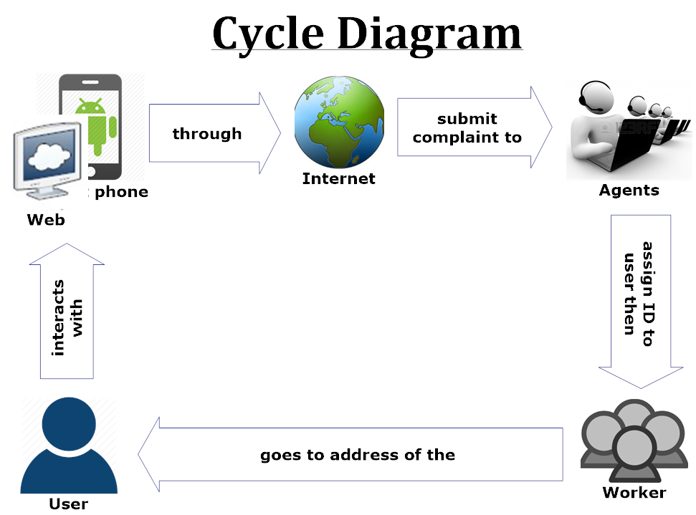
Project Scope

Slide 9
Literature Reviews
Study of Implementation of Society Management System ^{[1]}
In this paper, people are notified about every activity of the society through the application.
So, business oriented citizens without much interaction will be able to interact with their society’s daily activities.

Slide 10
Literature Reviews
Ubiquitous Smart Home System Using Android Application ^{[2]}
In this review an android application and an Arduino, as its server, is used to control the appliances of a home.
This methodology can be helpful to control the complaints of the society, by using internet server/domain instead of Arduino, as a connecting medium.

Slide 11
Literature Reviews
Implementation of Society Management System: SOCIETALES^{[3]}
The paper uses online posting of the complaints using android applications for any residential society.
A society has to deal with many complaints involving:
Water supply
Maintenance of electricity etc.
So to manage everything on a single platform would help to maintain a well-defined environment within the society with the help of:
Complaint box
My Complaints
Notice board
Meetings Schedule etc.

Slide 12
Literature Reviews
Ubiquitous Home Control and Monitoring System Using Internet of Things ^{[4]}
This project uses the Internet of Things (IoT) to monitor houses in the society and monitor/control appliances of the house too.
It uses wireless network or 3G/4G to connect 8051 microcontroller as a hosting controller.

Slide 13
Literature Reviews
Implementation of Facility Maintenance Management System using Smart Phones ^{[5]}
This paper proposes an integrated android based mobile application and a web based system that facilitates maintenance management in apartment buildings that saves unnecessary man power that can be used in other aspects.
The methodology of creating an integrated mobile application and web based system is useful to consult the idea of our project.

Slide 14
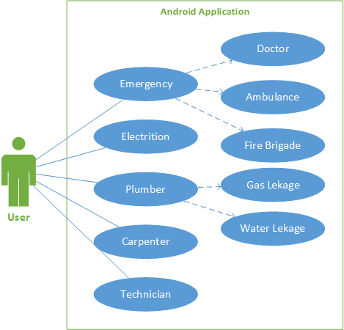
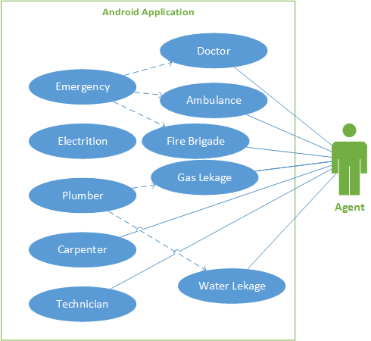
UML Diagrams (Android Application)

Slide 15
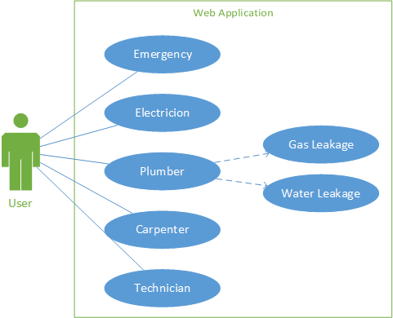
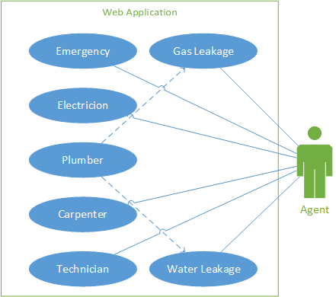
UML Diagrams (Web Application)

Slide 16
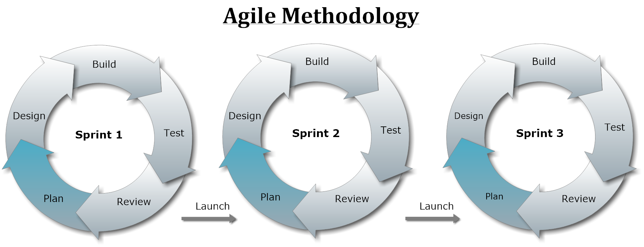
Methodology (Approach)

Slide 17
Project Plan (Gantt Chart)
Task Name | Duration | Start | Finish
FYP Gant Chart | 132 days | Tue 8/1/17 | Wed 1/31/18
Requirement Analysis | 51 days | Tue 8/1/17 | Tue 10/10/17
Elicitation of Requirement | 51 days | Tue 8/1/17 | Tue 10/10/17
Analysis of Requirement | 51 days | Tue 8/1/17 | Tue 10/10/17
Requirement Validation | 42 days | Mon 8/14/17 | Tue 10/10/17
Designing | 60 days | Mon 9/11/17 | Fri 12/1/17
Web Design | 30 days | Wed 9/27/17 | Tue 11/7/17
CSR Design | 30 days | Wed 9/27/17 | Tue 11/7/17
App Design | 60 days | Mon 9/11/17 | Fri 12/1/17
Implementation | 40 days | Mon 11/20/17 | Fri 1/12/18
Web Development | 20 days | Mon 11/20/17 | Fri 12/15/17
CSR Development | 20 days | Mon 11/20/17 | Fri 12/15/17
Application Development | 40 days | Mon 11/20/17 | Fri 1/12/18
Testing | 103 days | Mon 9/11/17 | Wed 1/31/18
Black Box Testing | 103 days | Mon 9/11/17 | Wed 1/31/18
White Box Testing | 103 days | Mon 9/11/17 | Wed 1/31/18

Slide 18
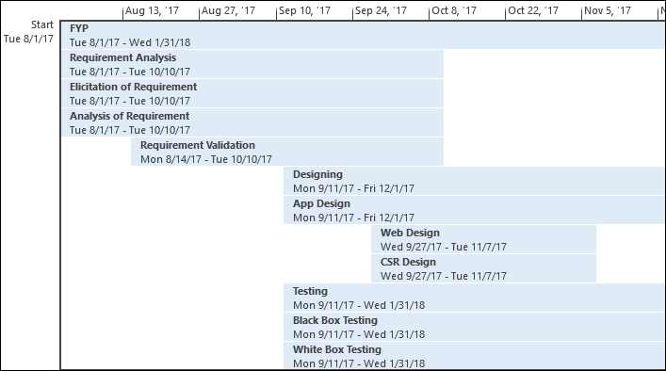
Project Plan (Timeline)

Slide 19
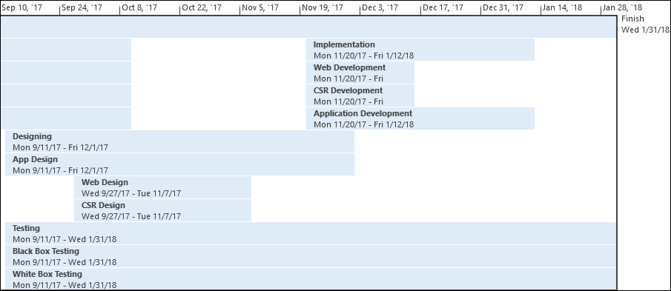
Project Plan (Timeline)

Slide 20
RACI Matrix
Responsibility, Accountability, Consultant, Informed.
 | Taha Amin | Areeb Vohra | Abdul Moiz
Design | R | I,C | A
Analysis | R,I | R | A,C
Development | C,I | R,A | R,C
Testing | A,I | R | A,C

Slide 21
Software Tools
Android Application Development:
Android Studio
Web Application Development:
Word Press
Sublime Text
Database
MySQL
Documentation:
MS-Office Suit
EndNote
Smart Draw / Microsoft Visio
MS-Project

Slide 22
Hardware Tools
Android Mobile – for application testing.
Desktop/Laptop – for Web & Android application development.
Internet (3G/4G) Device – for mobility of internet.

Slide 23
Budget of the Project
Android Mobile ≈ 20,000 PKR
Desktop/Laptop ≈ 25,000 PKR
Internet (3G/4G) device ≈ 4000 PKR
Domain ≈ 3,000 PKR/per annum
Total ≈ 53,000 PKR.

Slide 24
Project Deliverables
Proposal Report.
Requirements Analysis Documentation.
Design Documents (ER-Diagram, Design etc.)
Running Software Applications and their coding documents’ soft-copies.

Slide 25
References
Gavhane, Shivganga, Rutuja Vatharkar, Swati Sonar, and Pratiksha Patil. "Study of Implementation of Society Management System." International Journal of Computer Applications 132, no. 1 (2015): 34-36.
Kumar, Shiu. "Ubiquitous Smart Home System Using Android Application." arXiv preprint arXiv:1402.2114 (2014).
Vatharkar, Rutuja, Pratiksha Patil, Swati Sonar, and Shivganga Gavhane. "Implementation of Society Management System: Societales.“
Kumbhar, Miss Dardi Madhura Rajendra3 Miss, and Amruta Dilip. "Ubiquitous Home Control and Monitoring System Using Internet of Things." (2016).
Joo, Young-Do. "Implementation of Facility Maintenance Management System Using Smart Phones." The Journal of The Institute of Internet, Broadcasting and Communication 13, no. 1 (2013): 191-97.

Slide 26
That is All

